Slide 1


Artificial Intelligence vs Knowledge-Based Systems
BS Artificial Intelligence Course · Knowledge-Based Systems
Muhammad Irtisam
Muhammad Umer
Bilal Tariq
Ihtesham

Slide 2



Introduction
Artificial Intelligence
Systems that learn and adapt from data — powering modern automation and prediction.
Knowledge-Based Systems
Systems that use expert rules and logic to replicate domain-specific decision-making.
Why Compare?
Understand strengths, limitations, and best use cases for each paradigm.
Course Objectives
Explore definitions, key differences, real-world applications, and future trends.

Slide 3
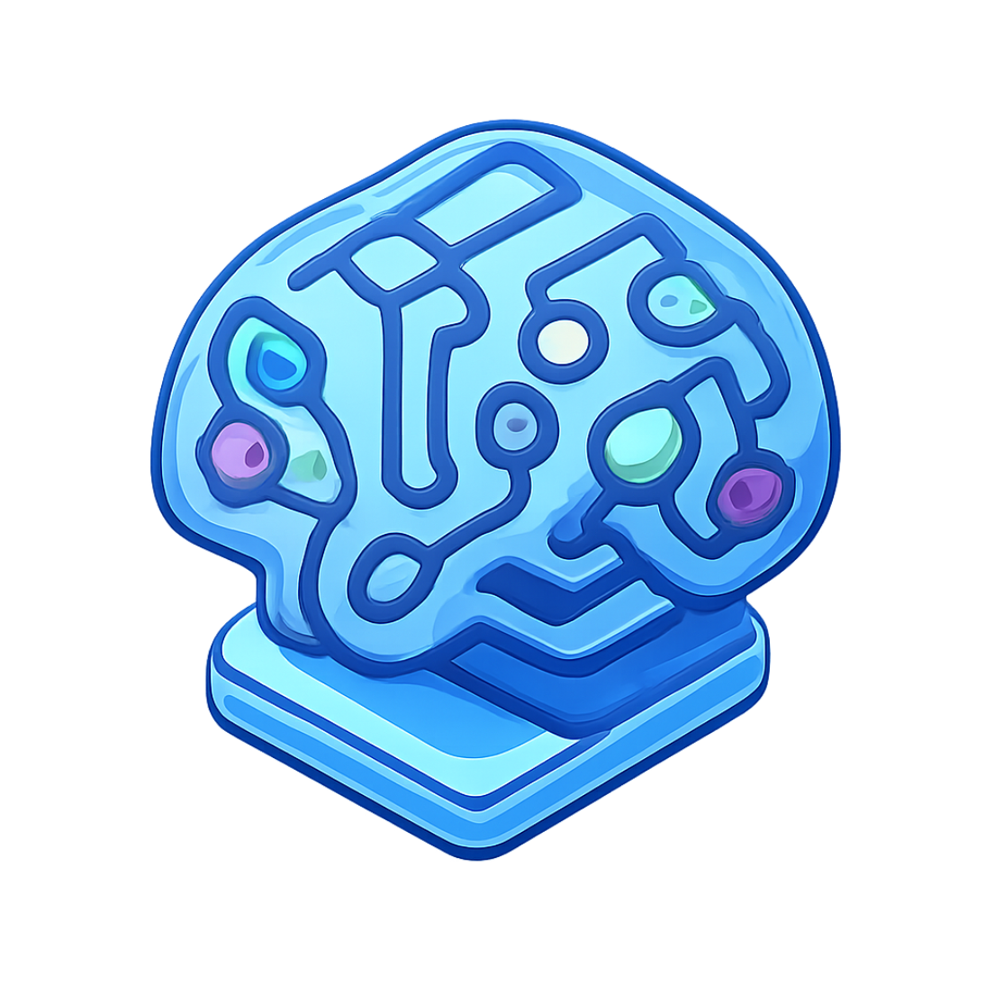
What is Artificial Intelligence?
Definition
Technology that enables machines to learn from data and make intelligent decisions autonomously.
Key Characteristics
Learning, pattern recognition, and adaptation
Automation of complex cognitive tasks
Types
Machine Learning · Deep Learning
Neural Networks · NLP
Workflow
DATA
TRAINING
MODEL
PREDICTION

Slide 4
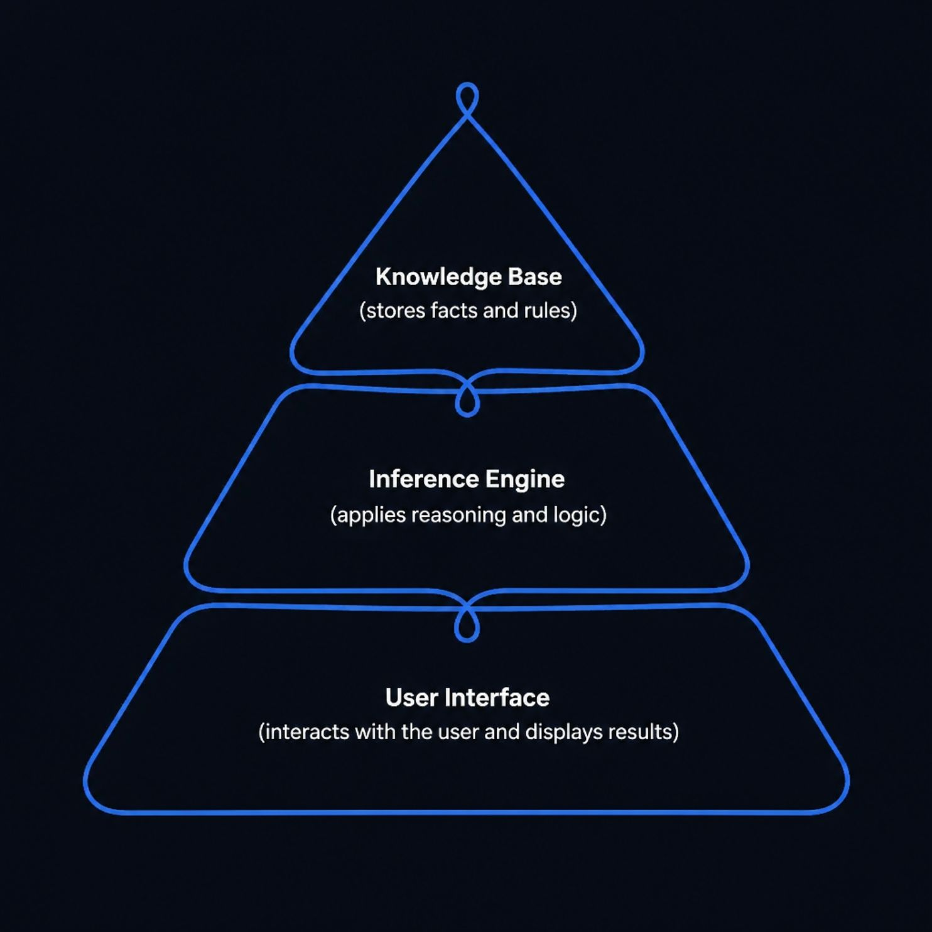
What is a Knowledge-Based System?
Definition
An expert system that uses encoded human knowledge and logical rules to replicate expert decision-making in specific domains.
Example Rule
IF fever AND cough THEN possible flu
Workflow
KNOWLEDGE
RULES
INFERENCE
DECISION

Slide 5
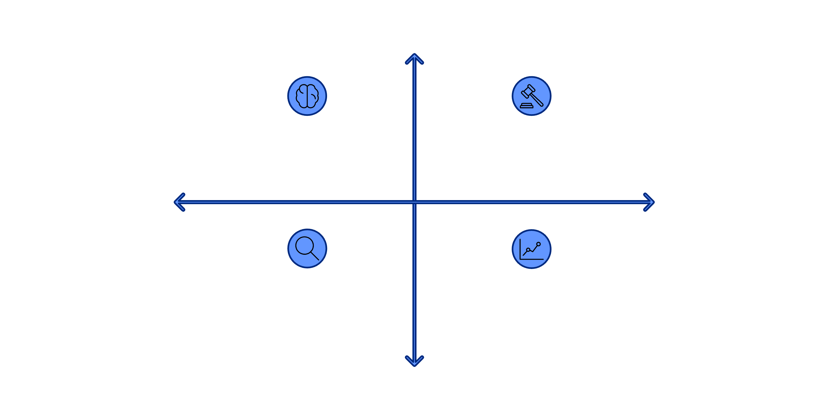
Working Process Comparison
High Discovery
AI: Learns from data to find patterns
KBS: Encodes expert rules for decisions
Low Explainability
High Explainability
KBS: Inference engine yields explainable outputs
AI: Predicts outcomes and uncovers insights
Low Discovery
The fundamental distinction: AI learns from raw data autonomously, while KBS applies pre-defined expert rules. AI excels at discovering unseen patterns; KBS delivers transparent, auditable decision logic.

Slide 6
Key Differences
Dimension
Artificial Intelligence
Knowledge-Based Systems
Learning
Learns automatically from data
Requires manual rule creation
Knowledge Source
Raw data and patterns
Encoded expert knowledge
Explainability
Often a "black box"
Transparent and auditable
Flexibility
Adapts to new data
Needs manual rule updates
Speed
Fast inference at scale
Depends on rule complexity

Slide 7





Advantages of AI
Automatic Learning
Pattern Discovery
Predictive Analytics
Learns from large datasets without manual programming
Uncovers hidden relationships humans may not detect
Enables accurate forecasting from historical data
Unstructured Data
Continuous Improvement
Handles images, text, and audio with ease
Performance improves as more data becomes available

Slide 8




Advantages of Knowledge-Based Systems
Transparent Reasoning
Consistent Reliability
Expert Knowledge Capture
Low Data Requirements
Every decision traces back to explicit, auditable rules — no hidden logic.
Same input always produces the same rule-driven output, ensuring dependability.
Operates effectively without massive training datasets.
Domain expertise is directly encoded, preserving institutional knowledge.

Slide 9


Disadvantages at a Glance
AI — Limitations
KBS — Limitations
Black-box decisions — hard to explain why
No automatic learning from new data
Requires massive training data volumes
Knowledge acquisition is difficult and slow
Expensive compute resources and training time
Requires constant maintenance and rule updates
Prone to bias inherited from training data
Limited to specific domains and problem types
Difficult to guarantee safety and reliability
Struggles with novel or unexpected situations

Slide 10



Real-World Applications
AI Applications
KBS Applications
Hybrid Approach
Healthcare diagnostics and imaging
Fraud detection in banking
Autonomous vehicles
Chatbots and recommendation engines
Medical diagnosis support systems
Loan approval and credit scoring
Legal and compliance advisory
Industrial troubleshooting tools
Combines AI learning with KBS rules
Delivers explainable AI decisions
Best of both paradigms
Growing trend in critical systems

Slide 11


Key Takeaways & Future Trends
AI
Data-driven, adaptive, powerful at scale — best for complex, high-volume problems
KBS
Rule-driven, transparent, reliable — best for well-defined expert domains
Hybrid Future
Neuro-symbolic AI blends both: learning power + explainable reasoning
Choose Wisely
Context determines the right tool — no single system fits every problem
The future of intelligent systems lies in combining AI's learning capabilities with the transparency of Knowledge-Based Systems.

